Slide 1
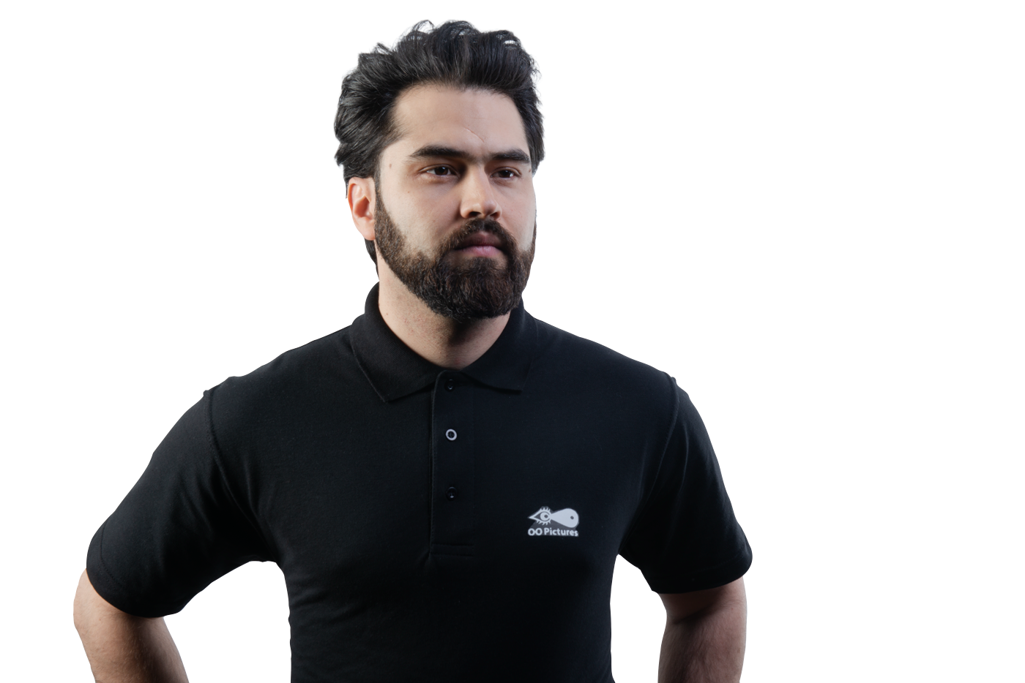
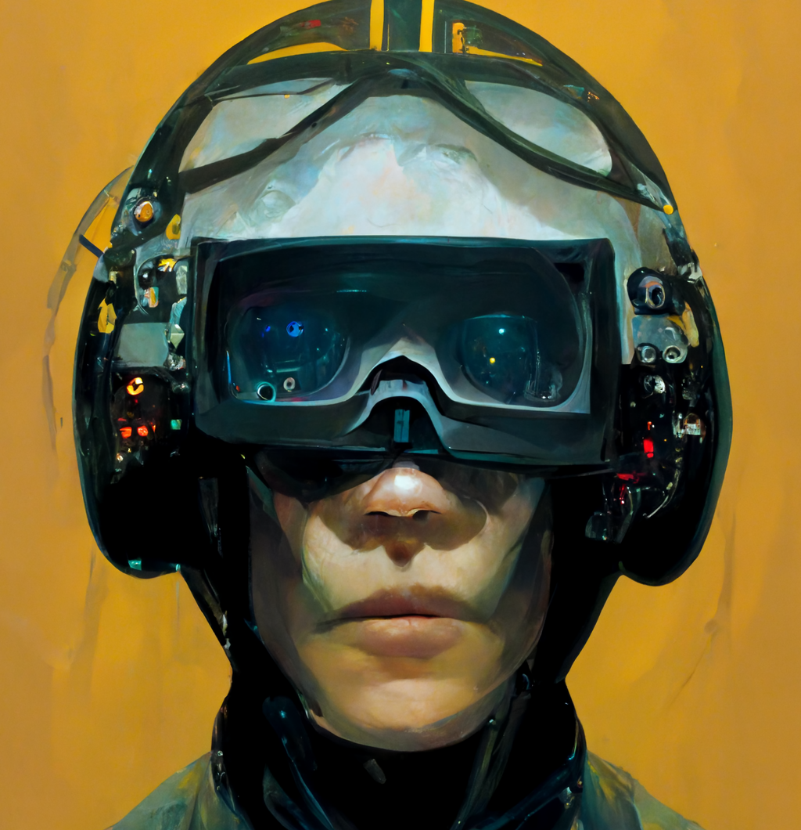
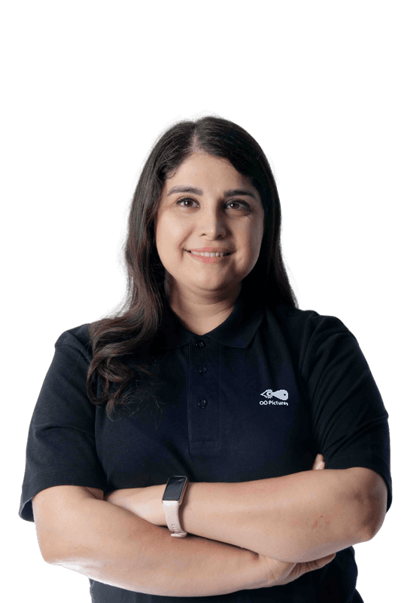


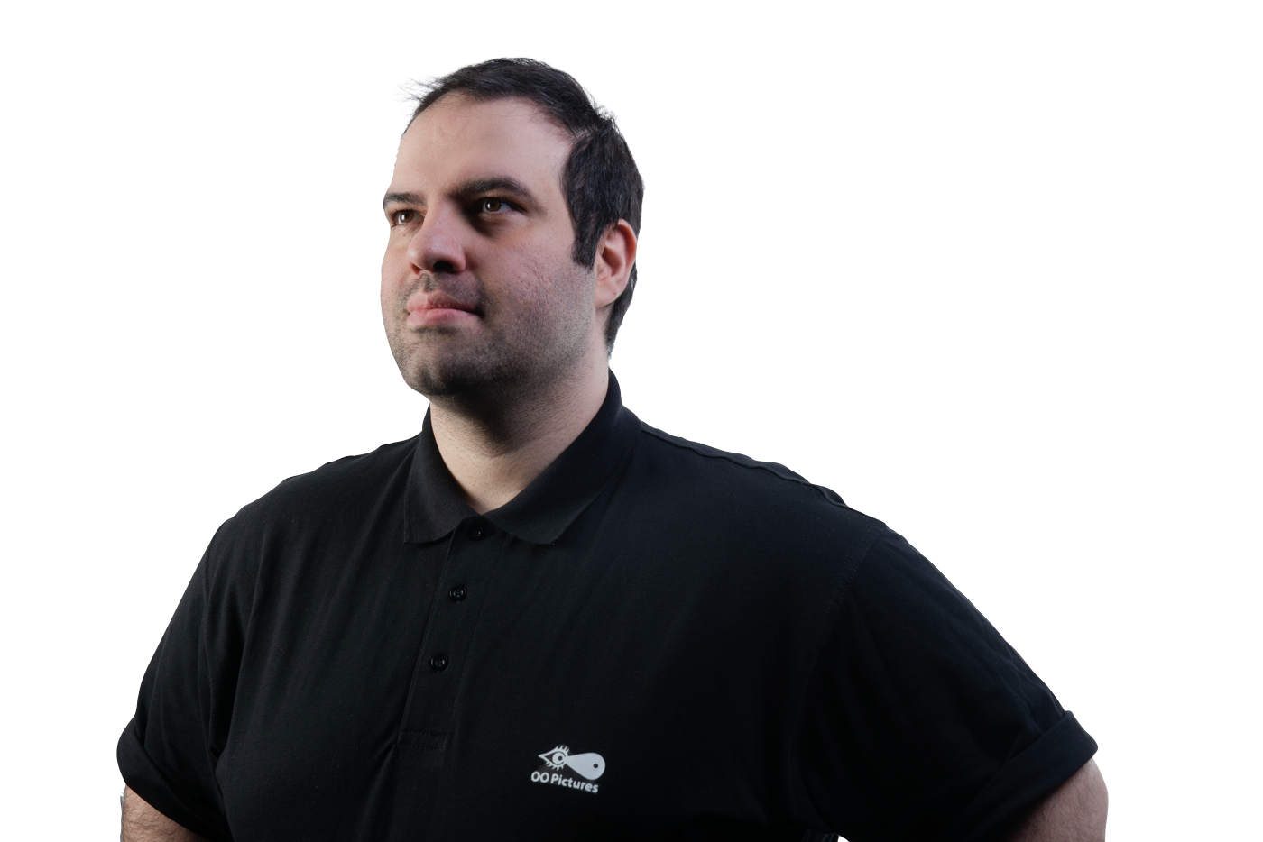
Sucher.Tech Team
WeAreVR Hackathon-edition#1
Virtual Cockpit Concept
Farbod Firoozi
Prototype, UX
Product Manager
Sepideh Azari
Napkin Idea:
Designing and Programming a concept for a helicopter cockpit in Unreal Engine for a simplistic and intuitive transition to VR for helicopter pilots
Research, UI
Presentation
Mehrdad Mansouri
Full Stack Developer,
Innovation Lead

Slide 2
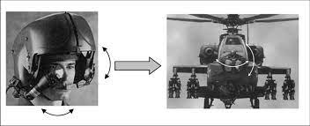
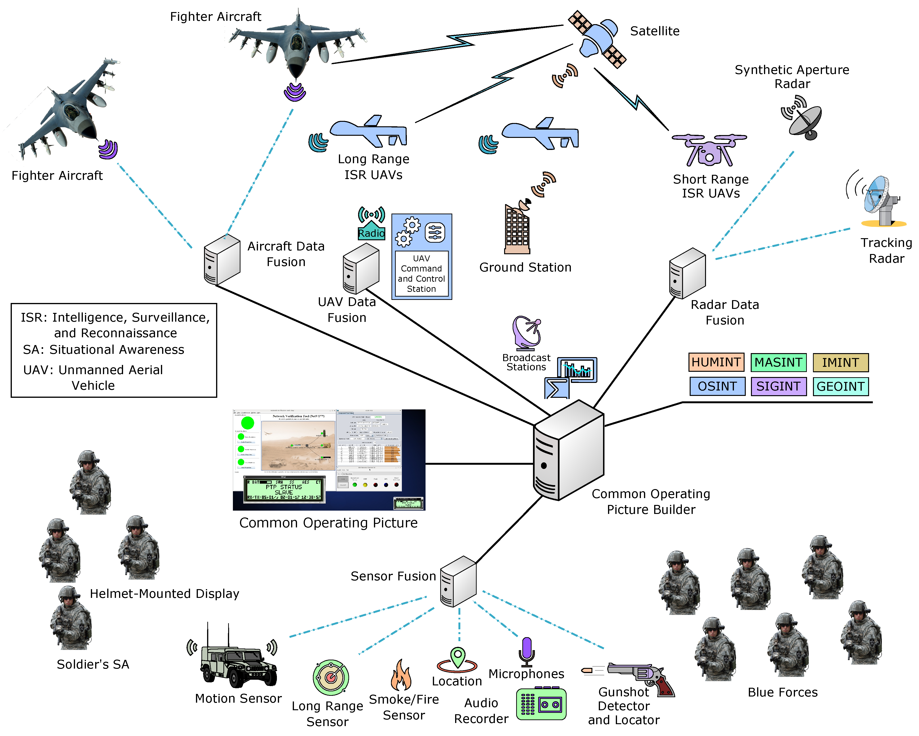
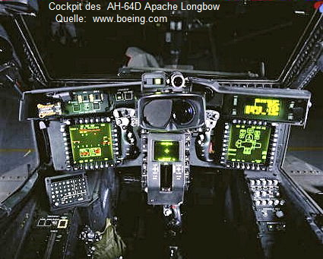
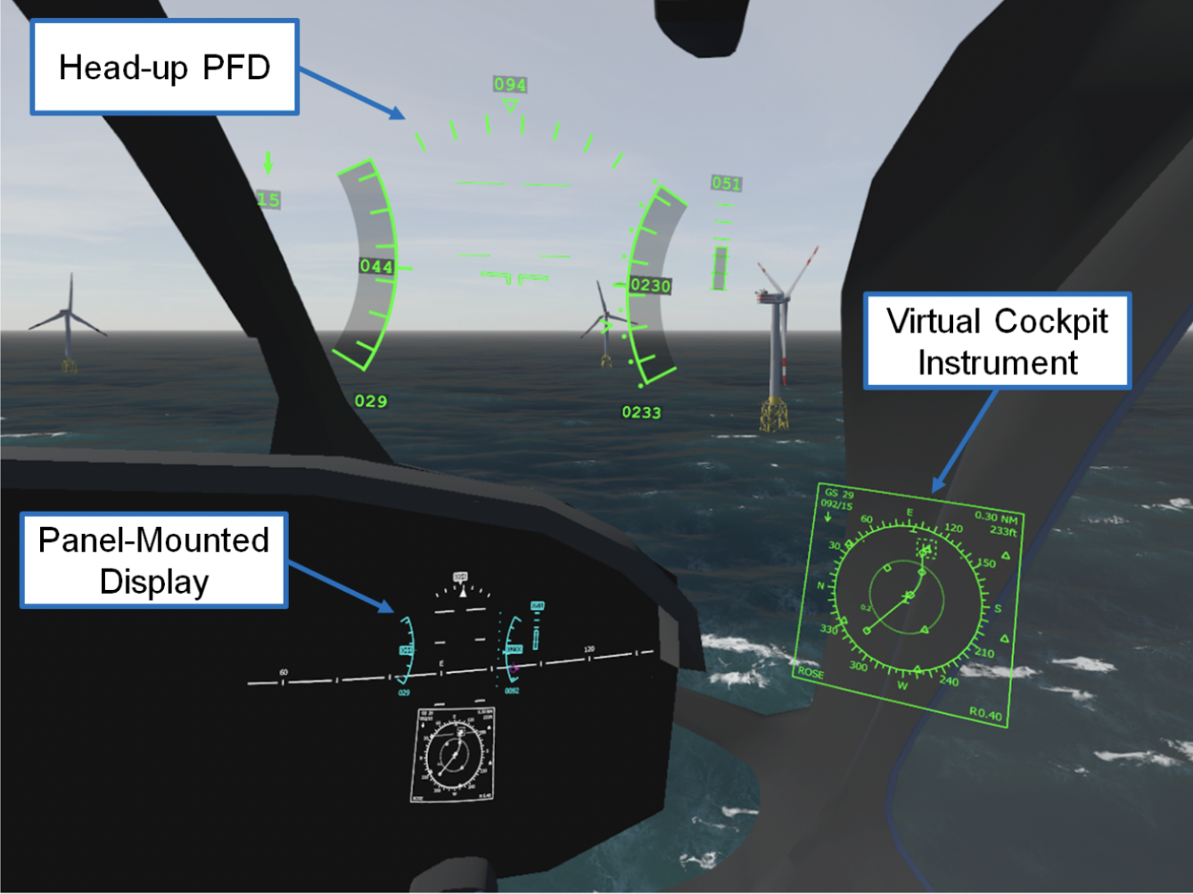
State of the Art
Redesigned cockpits must be optimized for smooth pilot interaction, while avoiding information overload
Making the Cockpit of the future a Reality via optimized HMI
Early 1980s
1990s
The 2000s
2015 -ongoing
AH-64 Apache
first operational, integrated helmet-mounted display (HMD) for helicopter pilots
The development of digital cockpits, HUDs & tools for aircrew systems design
Aviation Displays get modernized and psychology of flight is investigated and obstacle warnings is embedded
DLR – Designing a Virtual Cockpit for helicopter offshore Operations & Virtual Cockpit Instrumentations

Slide 3

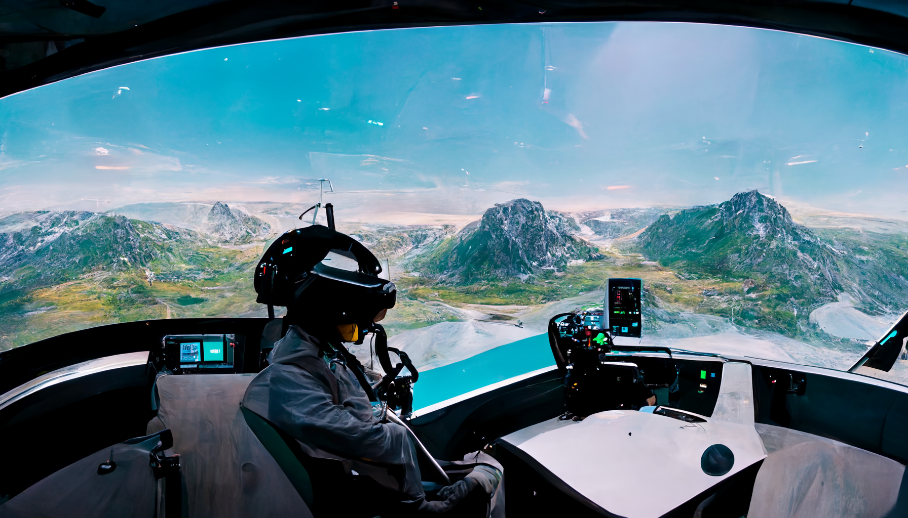
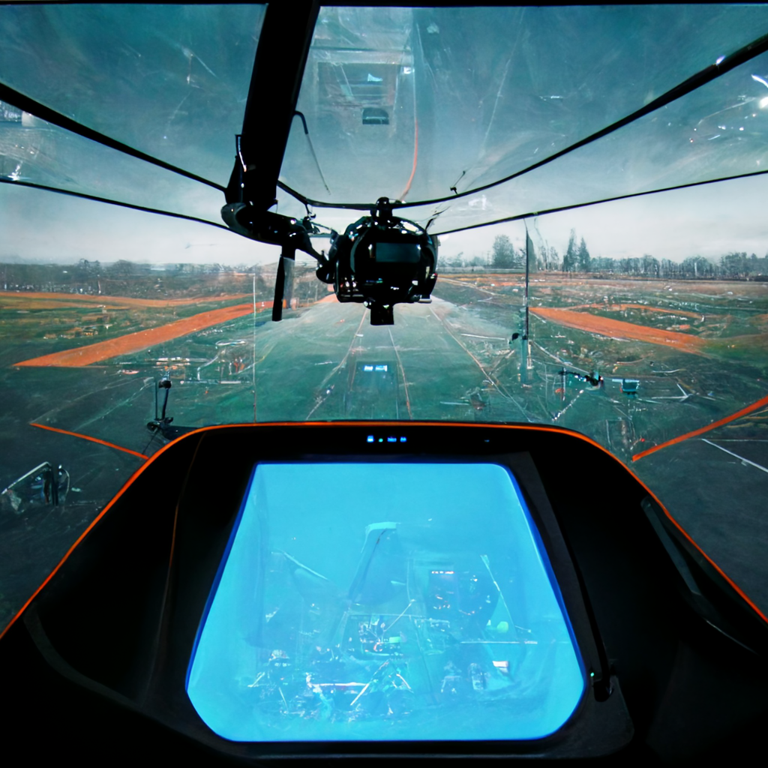
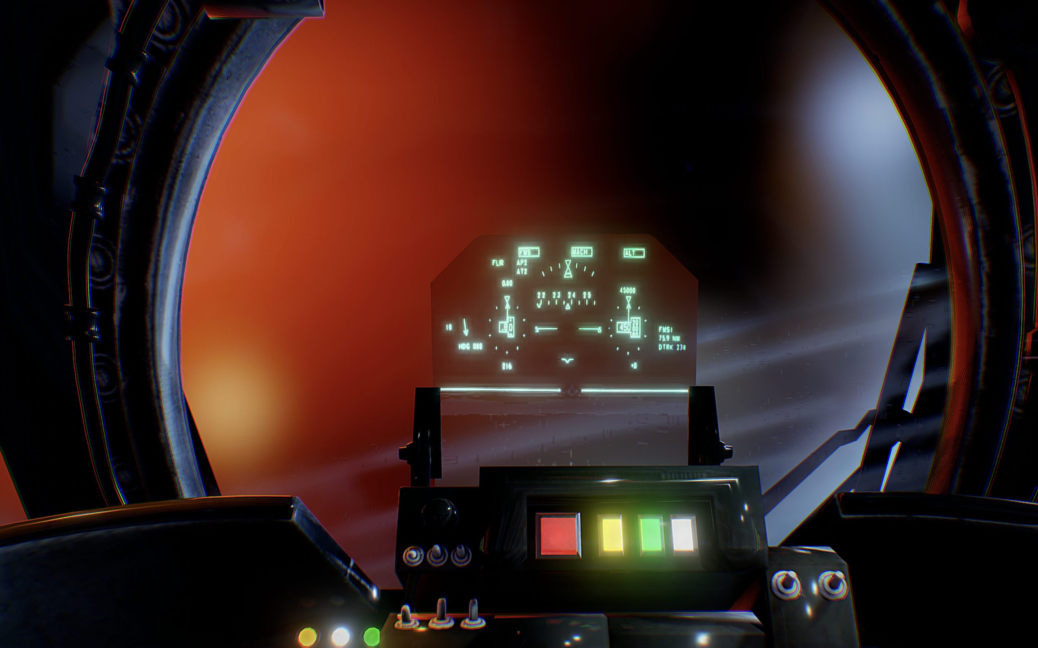
Ideation
In the Ideation phase we started to think free and use the mid- journey AI to visualize our ideas
We decided upon the following:
The main Flight Parameters being minimally shown on the default HUD mode (customizable).
Alert Notifications & Navigations to be shown on the main monitors just in front of the pilot.
Flight Control not to be dependent on External Physical Gear
Having an option for the pilot to “See Through Cockpit” (STC Mode).

Slide 4
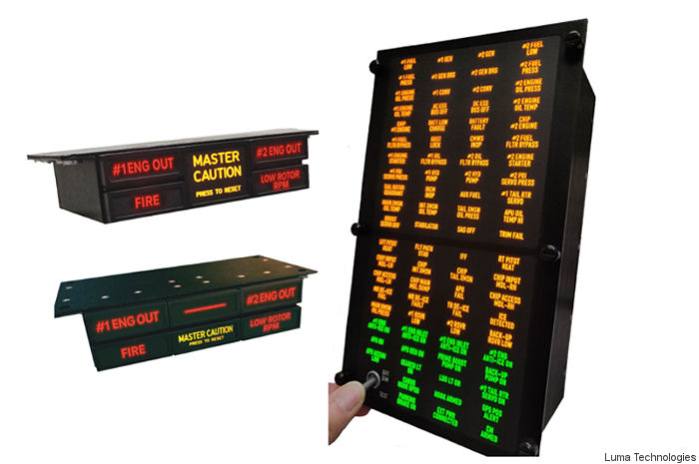
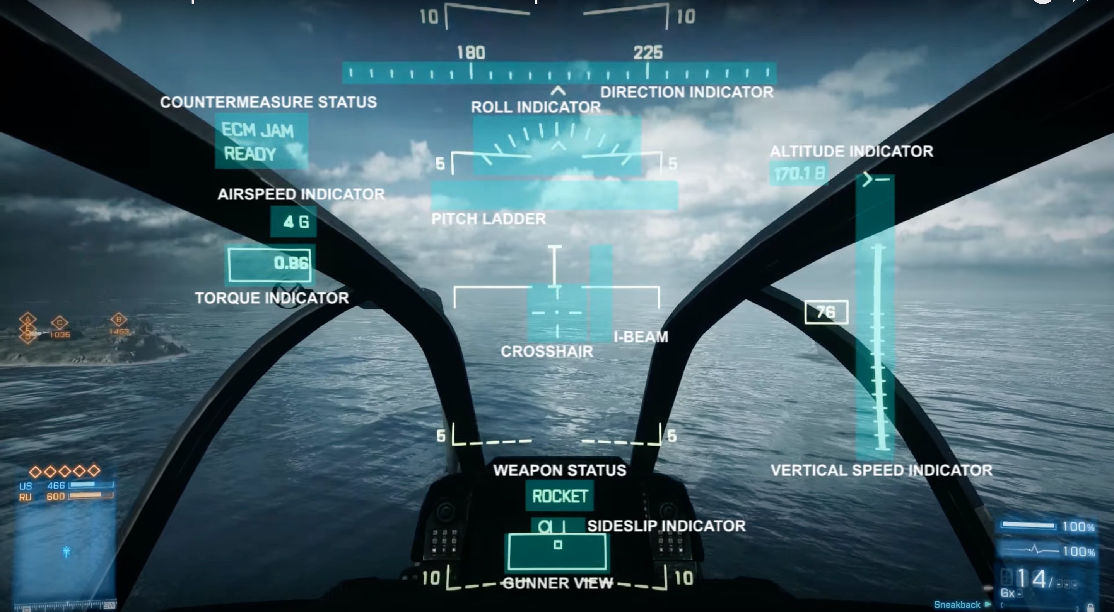
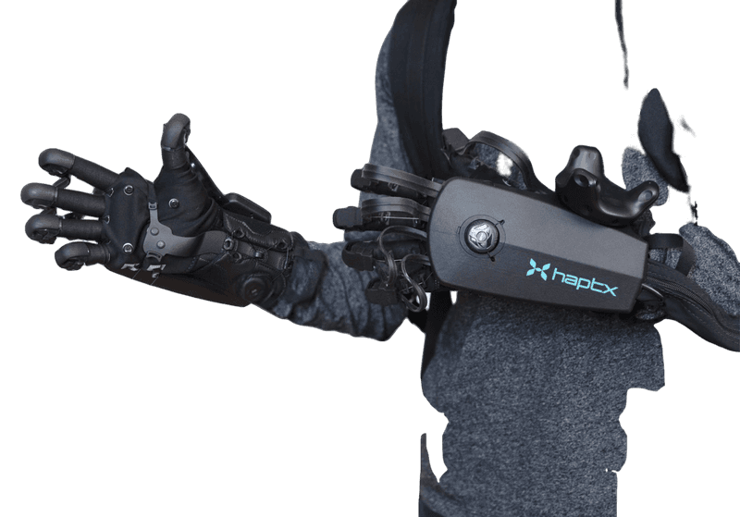

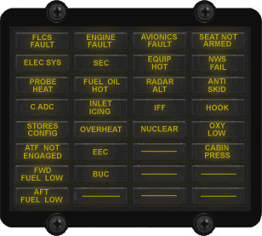
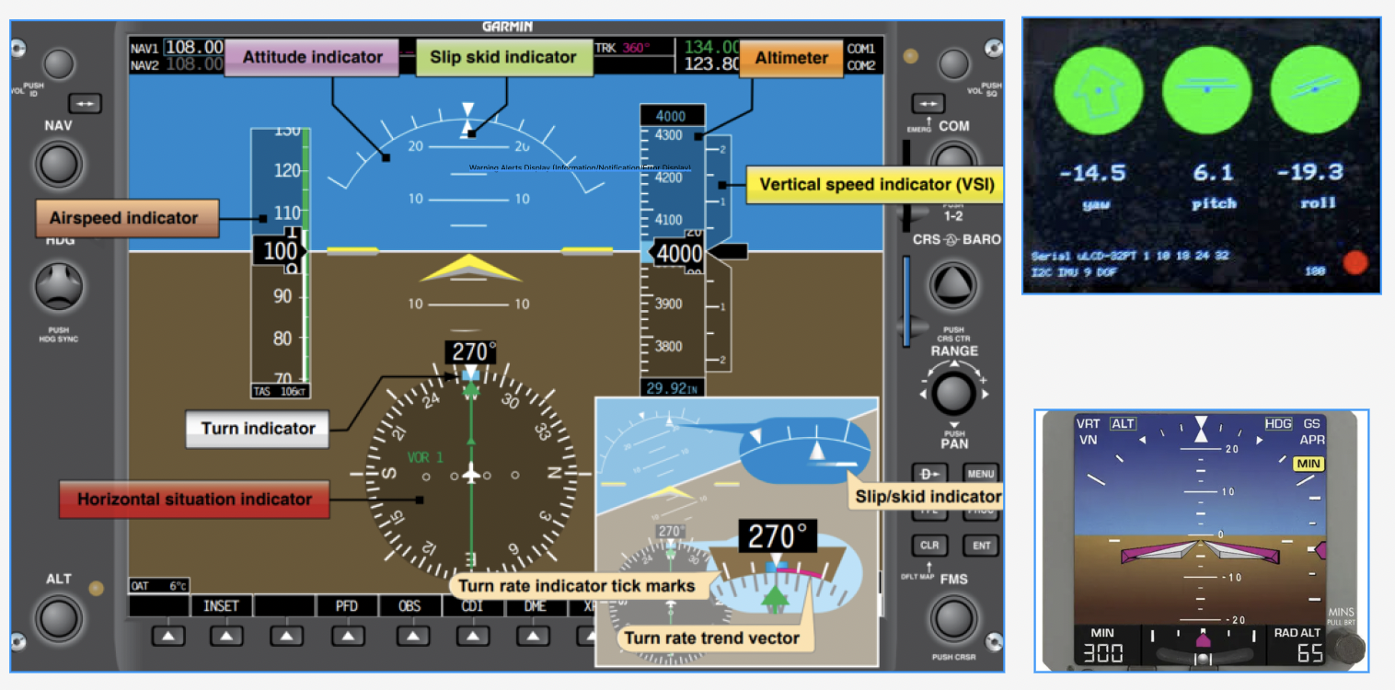
Our Target
Intuitive & Simplistic Flight parameter on HUD
Attitude, Flight Altitude, Air speed (TAC, IAC, no exceeding speed), Navigation (IFR, VFR), Fuel/Battery charge ,Ground Speed, Variometer, RPM Indicator
Alert Notification on Main Monitor
Fuel, Discharge alert, Low Altitude, Engine Temperature, Oil Pressure/-Temperature, Exhaust Temperature, Non Exceeding Vertical Speed, Rotor to Engine Speed, Fire
Hand-Controlled & Haptic-Driven
A unified vision for aircraft control using Haptic Gloves. Emergencies will be sensed.

Slide 5


Our Prototype
We created our Prototype in Unreal engine and added a hand tracking device to the VR headset.
Due to unavailable interface between the Unreal Engine and any of the flight simulators we can only test inside Unreal Engine.

Slide 6
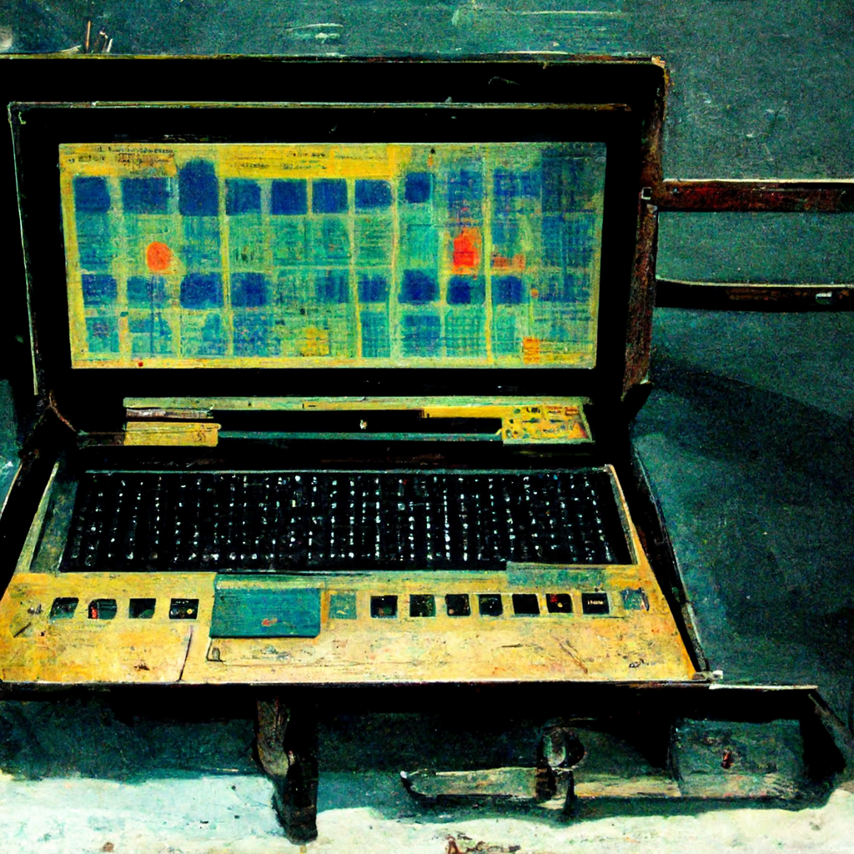
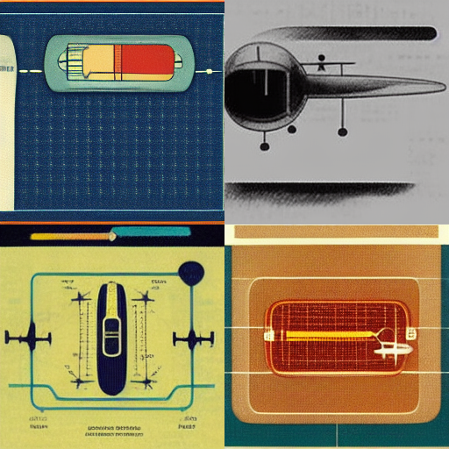
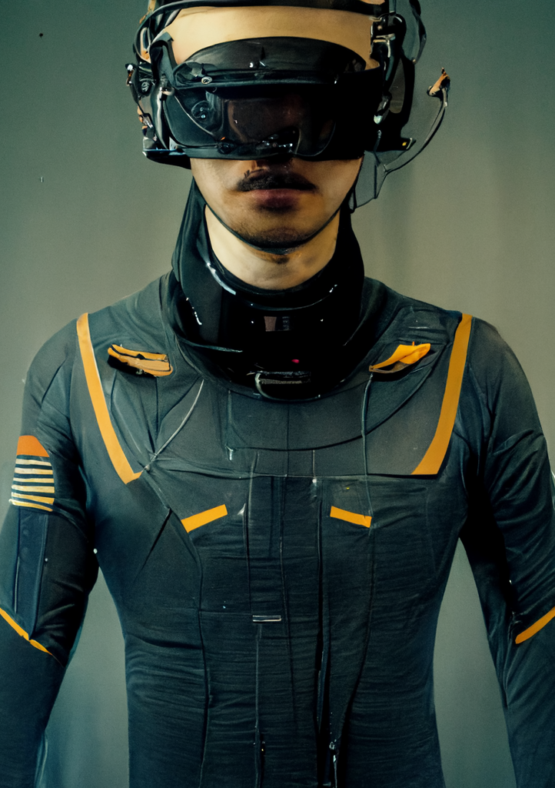
Time efficient Calibration by means of Condition Monitoring
Predictive Monitoring by mean of creating a twin model of the sensor network.
Air Traffic Control & Airport Taxing Routes Navigation app
Our Vision
Creating a World Wide Augmented Taxiways & Air Traffic Control cockpit-embedded with industry standard symbology.
The following are three products/business ideas that we consider to serve as interesting business models for Litef GmbH to delve into, thus changing the future of VR Cockpits.
Sensors for Haptic Body-suit
Designing an interface for transmitting Sensors values to the body for the purpose of giving real-world feedback to the pilot, operating an aircraft remotely via VR.

Slide 7

Thanks
for your
Time.
Please ask any Questions.
We are ready to be challenged!

